Slide 1

Plan AI
Team 1

Slide 2

Executive Summary
Plan AI is a web application that focuses on statistical analysis and uses AI-based recommendations to enhance the user’s productivity. It provides users with an intuitive platform to create, manage, and track their tasks while also receiving personal insights and recommendations to improve their daily efficiency.

Slide 3
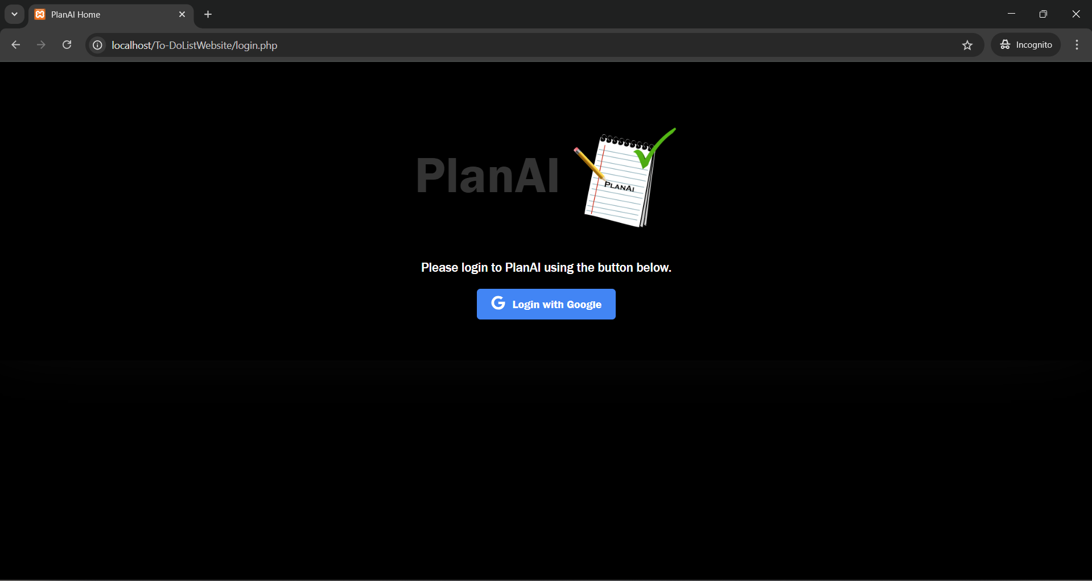
Welcome to Plan AI

Slide 4
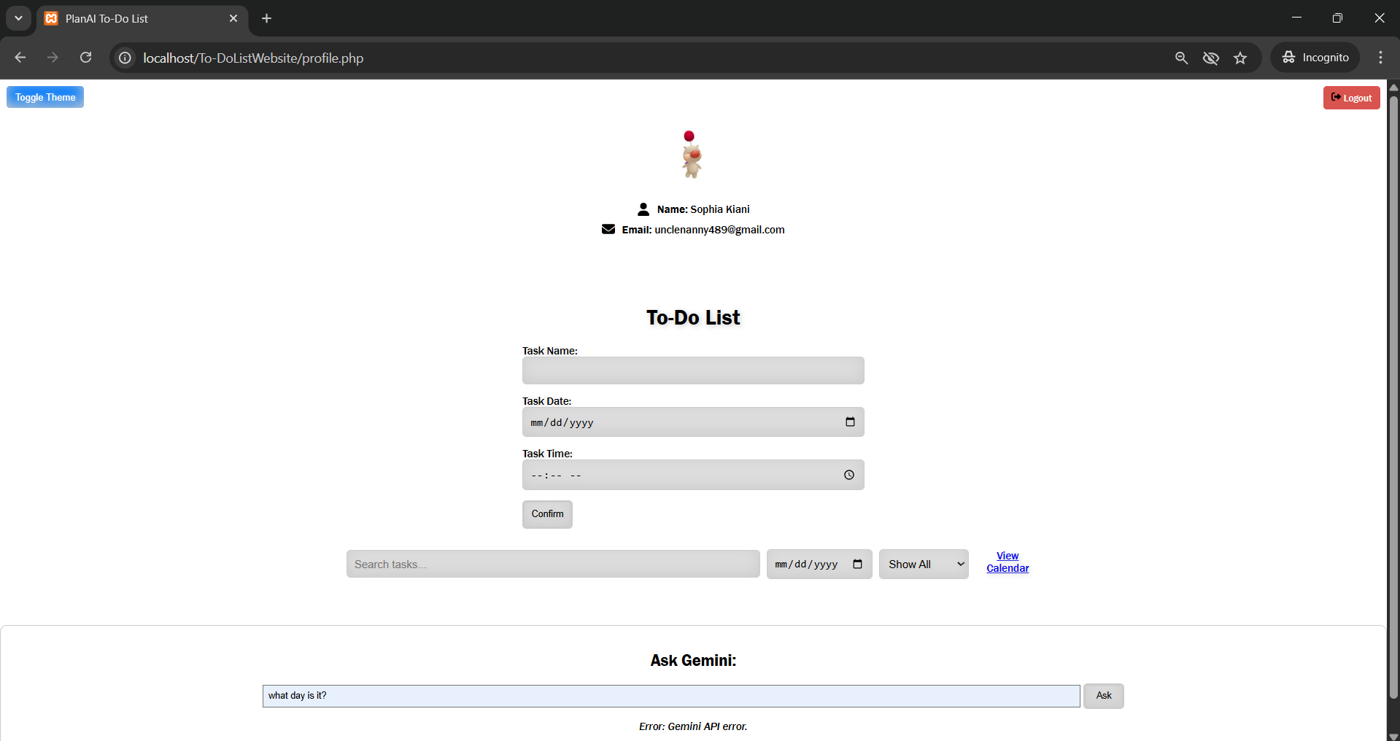
Our User Interface

Slide 5
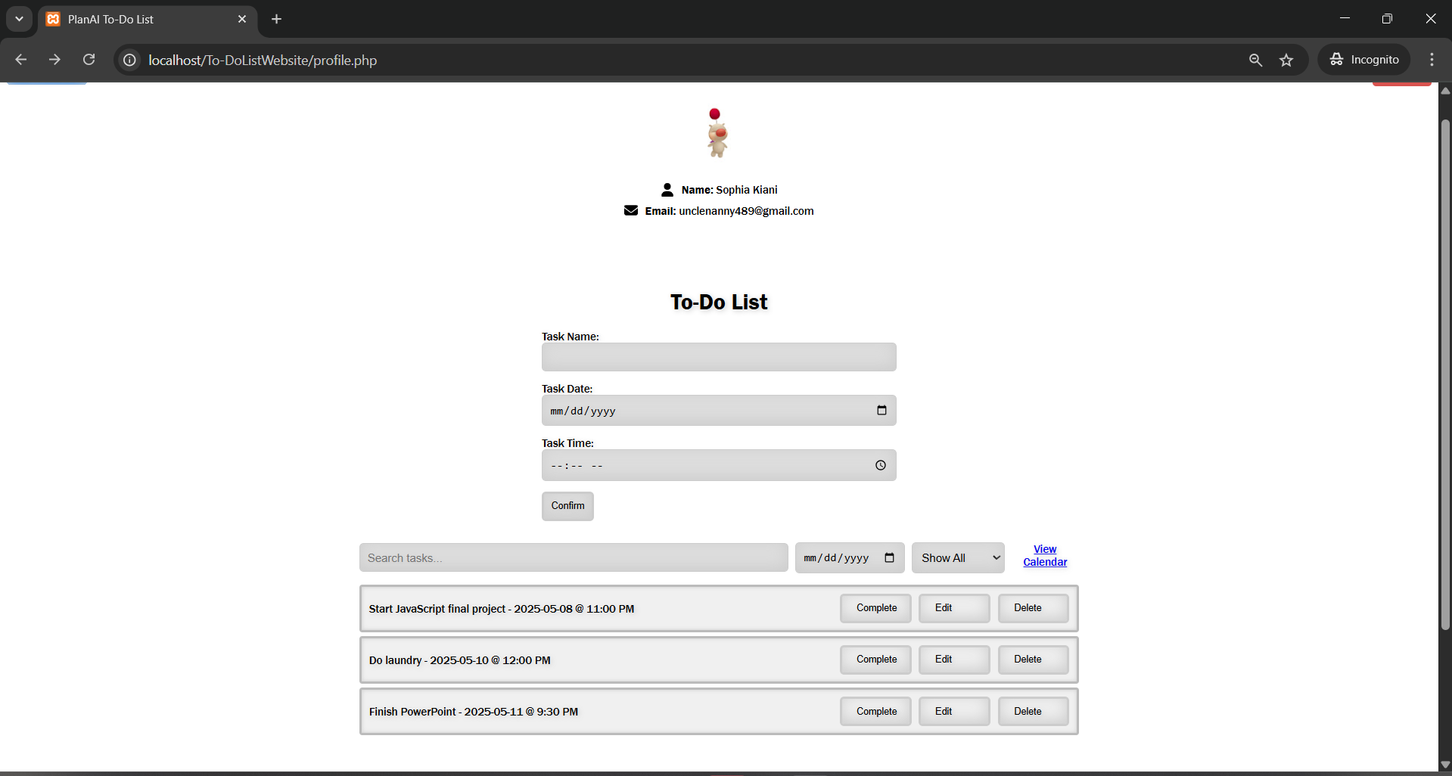
Tasks added

Slide 6
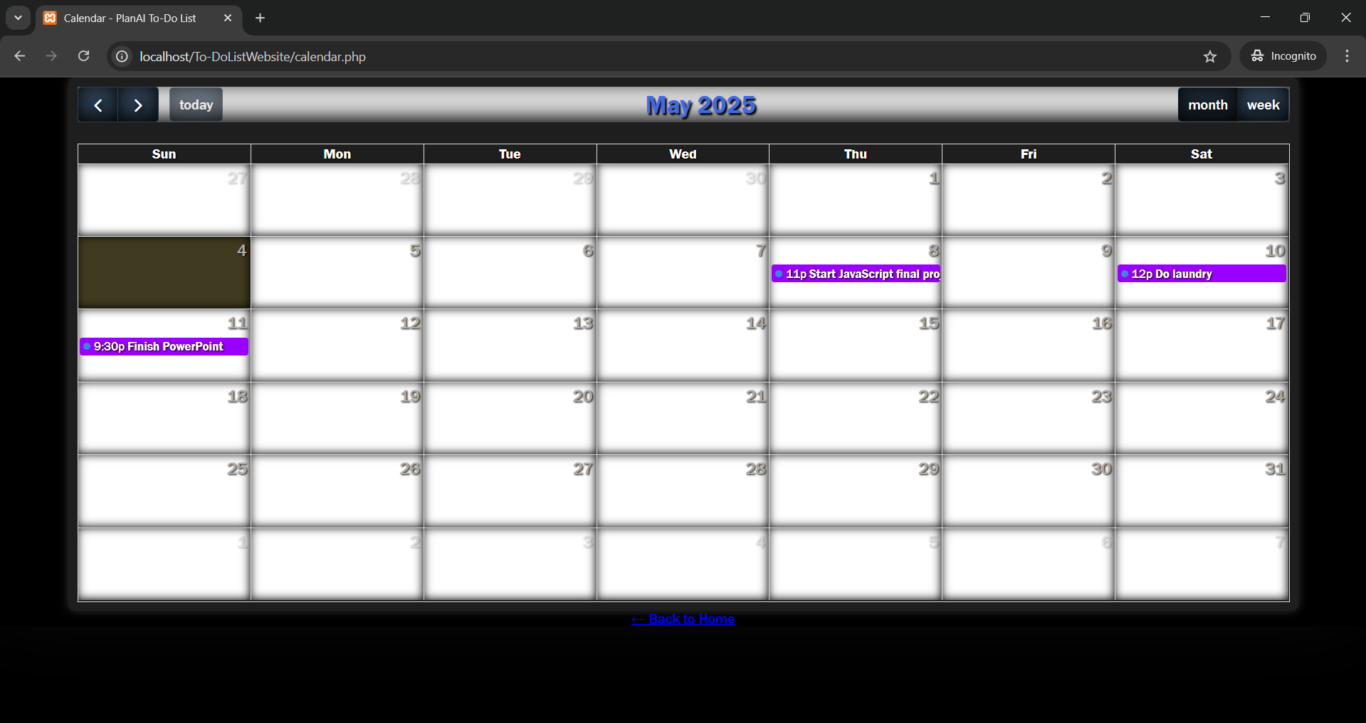
User’s calendar view
The tasks that the user enters are fetched from the database and shown in their personal calendar.

Slide 7
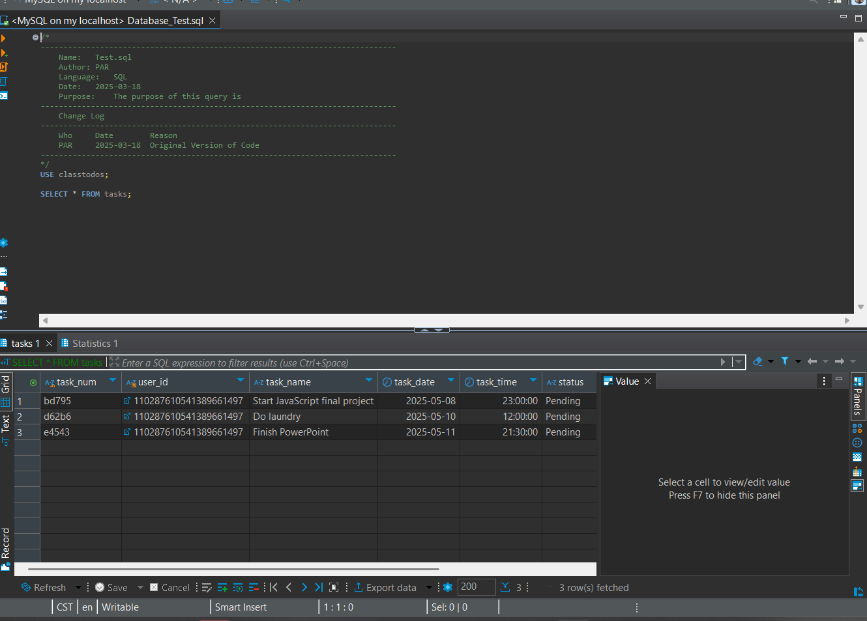
Database connection
Tasks that the user entered are successfully loaded into the database.

Slide 8
Changes that were made
We were going to use Google Calendar API, then changed to using Full Calendar
Adding AM/PM to tasks
Adding the toggle theme
Allowing a user to search through their task list

Slide 9
Lessons Learned
Before this project, no one on our team had used Github.
Communicate our schedules to ensure all could be there for team meetings.
We had to work together to get everyone’s environment set up properly, so everyone was on the same page.
Adjusting how we used XAMPP to fit our project’s needs
There was a lot of self learning through multiple resources and communicating that knowledge between team members to build onto our project.

Slide 10

Live Demo
Thank you for watching ☺

